Slide 1

Analyzing Zomato restaurants dataset in the city of Bangalore

Slide 2
Introduction
Bangalore officially known as Bengaluru, is the capital and the largest city of the Indian state of Karnataka. It has a population of more than 8 million and a metropolitan population of around 11 million, making it the third most populous city and fifth most populous urban agglomeration in India.
Located in southern India on the Deccan Plateau, at a height of over 900 m (3,000 ft) above sea level, Bangalore is known for its pleasant climate throughout the year. Its elevation is the highest among the major cities of India.

Slide 3
Questions that can be asked using the above mentioned datasets
Questions that can be asked using the above mentioned datasets
What is best location in Bangalore City for Continental Cuisine ?
Which areas have large number of Continental Restaurant Market ?
Which all areas have less number of restaurant ?
Which is the best place to stay if I prefer Continental Cuisine ?
What places are have best restaurant in Bangalore?
Objectives

Slide 4
Data
For this project we need the following data :
Bangalore Restaurants data that contains list Locality, Restaurant name, Rating along with their latitude and longitude.
Data source : Zomato kaggel dataset
Description : This data set contains the required information. And we will use this data set to explore various locality of Bangalore city.
Nearby places in each locality of Bangalore city.
Data source : Fousquare API
Description : By using this api we will get all the venues in each neighborhood.

Slide 5
Approach
Collect the new delhi city data from Zomato kaggel dataset
Using FourSquare API we will find all venues for each neighborhood.
Filter out all venues that are nearby by locality.
Using aggregative rating for each resturant to find the best places.
Visualize the Ranking of neighborhoods using folium library(python)

Slide 6
Results

Slide 7
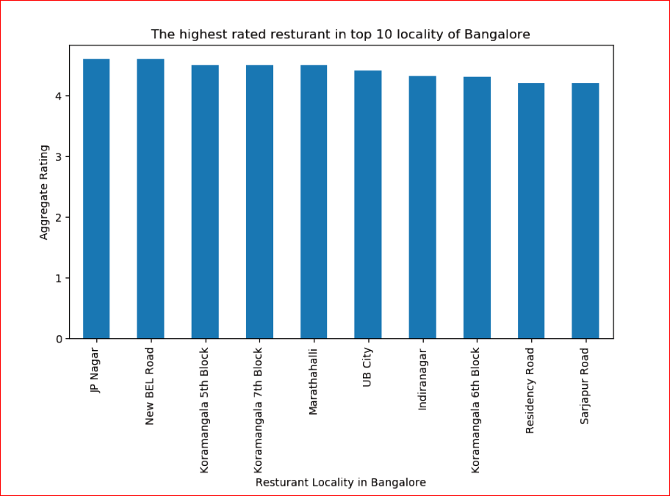

Slide 8
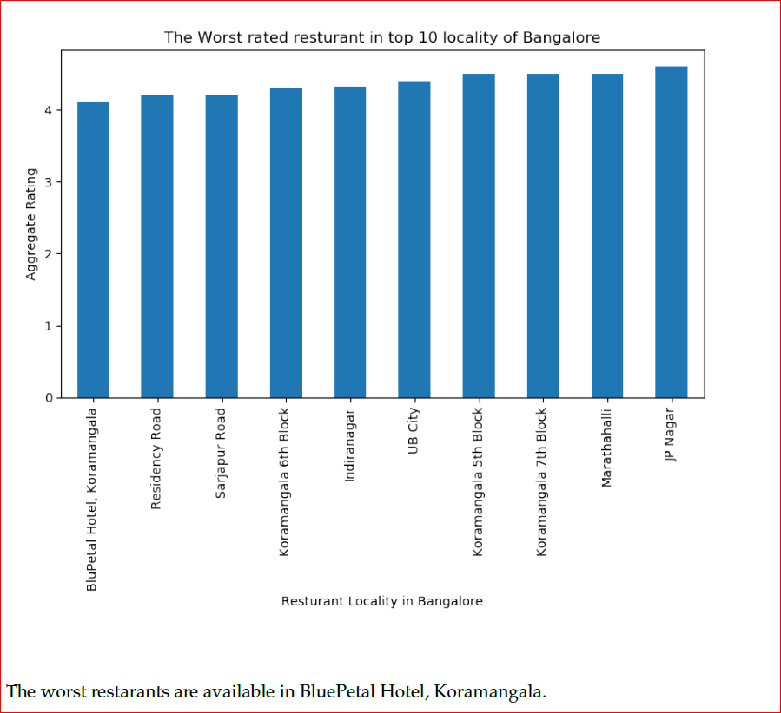

Slide 9
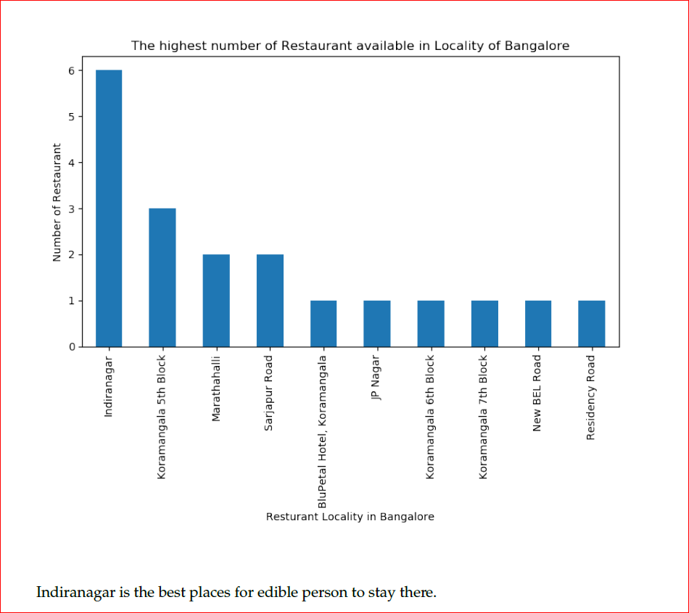

Slide 10
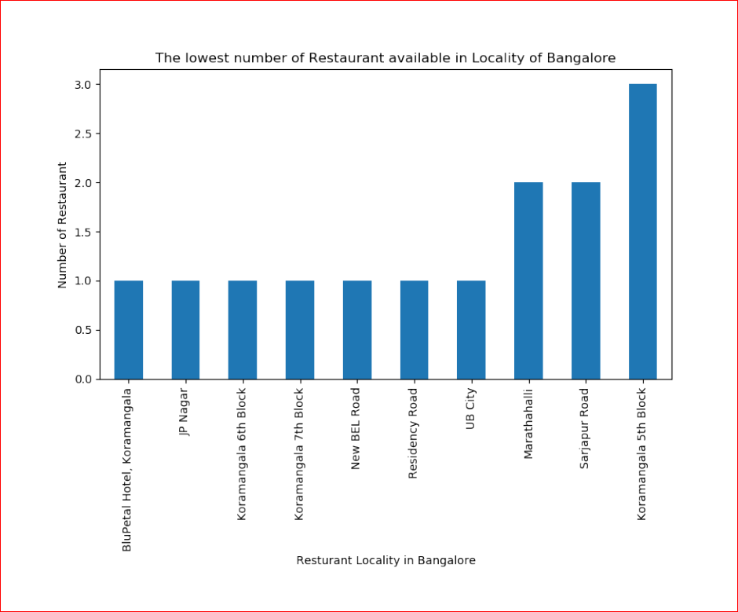

Slide 11
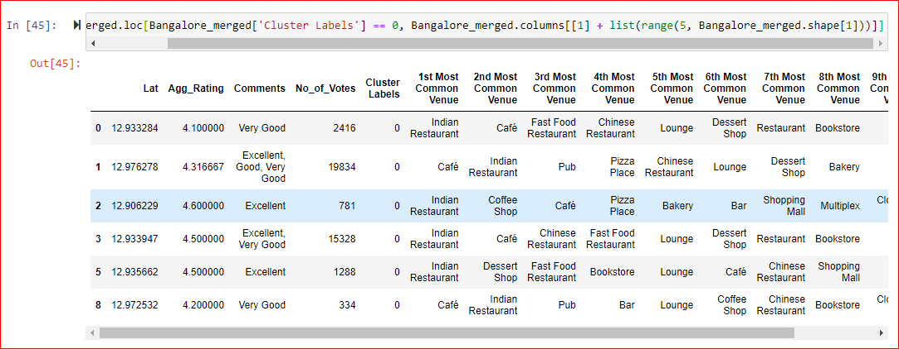
Cluster 1:
The Indian restaurants are most recommended venues nearby the locations.

Slide 12
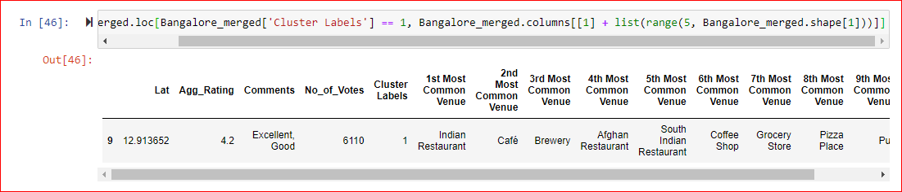
Cluster 2:
It is recommended for the Hotel and Nightclubs venues areas:

Slide 13
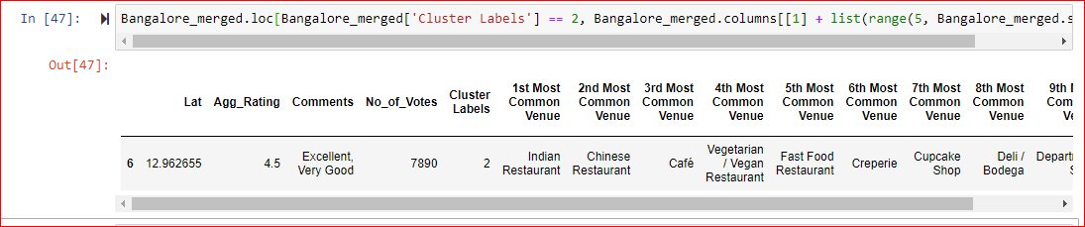
Cluster 3:
It seems like pizza place,

Slide 14
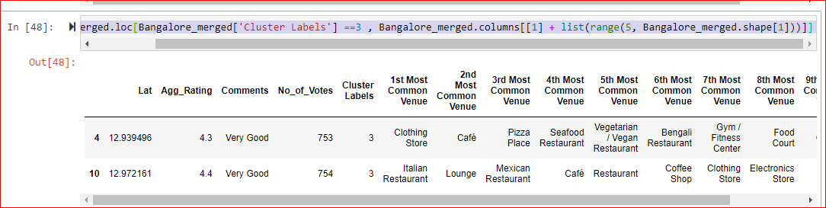
Cluster 4:
It’s most recommended for cafes

Slide 15
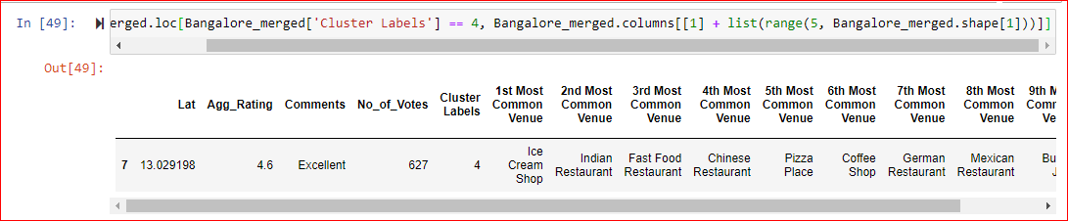
Cluster 5:
Fast food, cafes are the most recommended venues

Slide 16
Conclusion
Conclusion
Koramangala 5th Block is best Continental resturants.
The best restarants are available in JP Nagar and New BEL Road.
Sarijapur Road is the best place for Continental restaurant.
BluePetal Hotel, Koramangala, JP Nagar, Koramangala 6th Block, Koramangala 7th Block, New BEL Road, Residency Road and UB City are the locality which is not suitable for edible person in Bangalore city
#### Cluster 1: It is most recommended for Indian Restaurants.
#### Cluster 2: It is most recommended for Hotels and nightclub.
#### Cluster 3 and Cluster 5: It is most recommended for Fast food.
#### Cluster 4: It is most recommended for the cafe and pizza.

